Slide 1
Captain David Stebbins Recruiting Flight Commander AFROTC Det 535
Air Force
Reserve Officer
Training Corps (AFROTC)
Informational Brief
Sustaining the Combat Capability of America’s Air Force

Slide 2
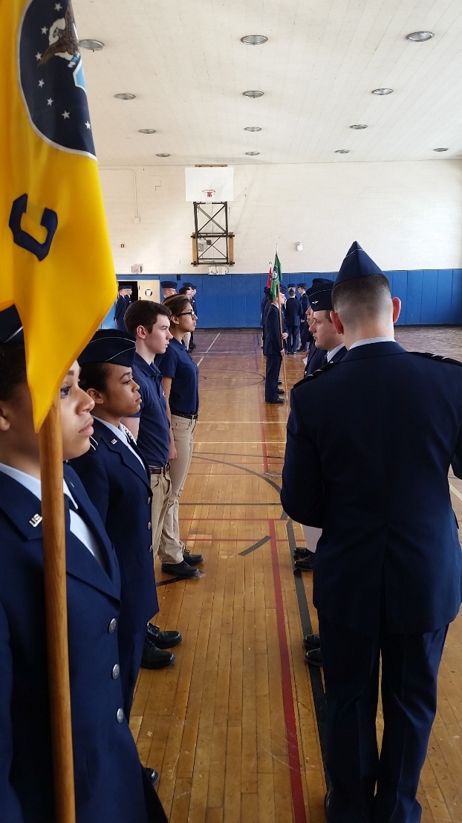
Overview
What is AFROTC?
The AFROTC Program
What are AFROTC Requirements?
AFROTC Det 535 Cross-Town Agreements
Examples of Air Force Benefits
AFROTC Extracurricular Activities
AFROTC Scholarships
High School Scholarship Program (HSSP)
In-College Scholarship Program (ICSP)
What is the Commitment after AFROTC?

Slide 3
What is AFROTC?
Air Force ROTC is designed to recruit, educate, and commission officer candidates as the Air Force’s future leaders through college campus programs around the country.
OUR MISSION
Develop Leaders of Character for Tomorrow’s Air Force

Slide 4
The AFROTC Program
Cadets are students first and cadets ALWAYS!!!
Freshmen and Sophomores try out the 1st two years without obligation (unless they are on scholarship)
First two years – approximately 6 hours per week
A one credit class, Lead Lab (~2 hrs), PT (~2 hrs)
Last two years – approximately 8 hours per week
A three credit class, Lead Lab (~2 hrs), PT (~2 hrs)
We want academically sound, physically fit, well-rounded and involved students with leadership potential

Slide 5
Typical 4 Year AFROTC Student Schedule
3
Graduation
Freshman
Sophomore
Junior
Senior
AS100
AS200
AS300
AS400
Field Training
Cadet competes for a Scholarship
Cadet is Contracted
Commissioning

Slide 6
What are AFROTC Requirements?
Be a full time college student attending a university or college affiliated with AFROTC
Be of good moral character with limited or no civil involvements
Meet weight and fitness standards
Maintain adequate GPA

Slide 7
Cross-Town Agreements

Slide 8
What are AFROTC Benefits?
Service to your country

Slide 9
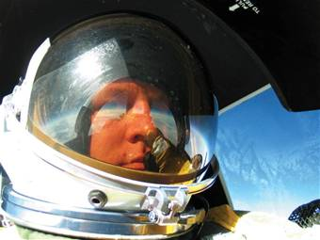
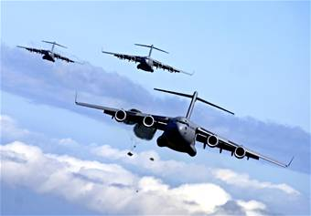
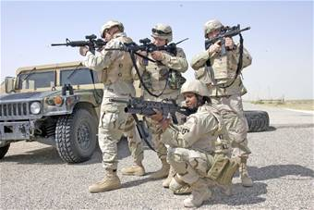
What are AFROTC Benefits?
Fulfilling and exciting Air Force careers!

Slide 10
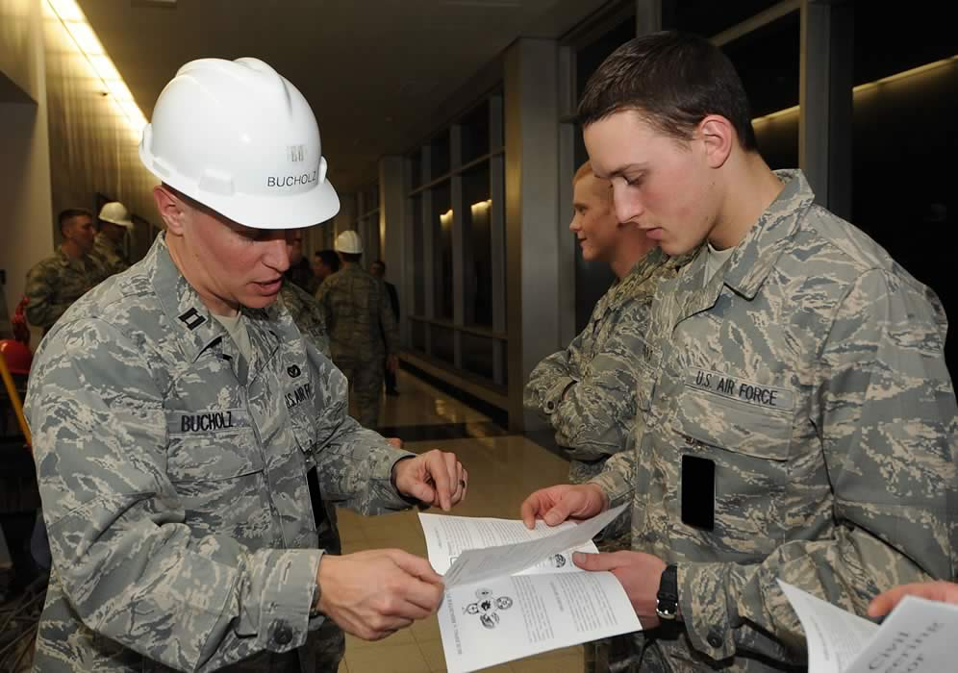
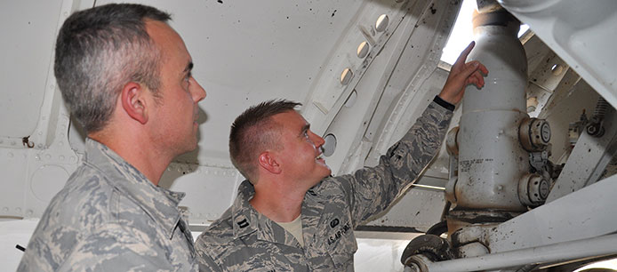
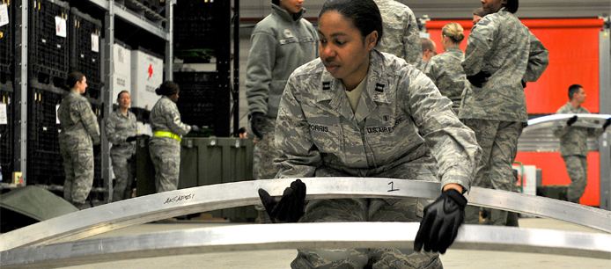
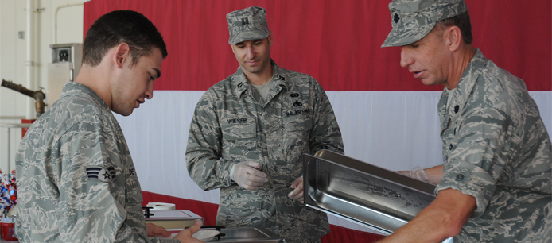
What are AFROTC Benefits?
Fulfilling and exciting Air Force careers!

Slide 11
Examples of Air Force Benefits
Starting compensation approx $50k per yr
Allowances for food and housing based on location
VA benefits
Full medical / dental care coverage
30 days paid vacation per year
Retire in 20 years!

Slide 12
AFROTC Extracurricular Activities
Extracurricular / Social Activities Examples
Drill Team – Spring Competition at RPI & potentially Villanova
Color Guard – Present the flag during games & other events
Arnold Air Society – Community Service Organization
Silver Wings – Community Service Org. (sister to AAS)
Pershing Rifles – Co-ed Military Fraternity
Civil Air Patrol – Incentive Flights
U.S. Air Force Base Visits and Military Incentive Flights
Intramurals (volleyball, softball, basketball, soccer, flag football, etc.)
Team-building: Paint Ball, Obstacle Courses, Ropes Courses
Detachment Events & Outings (picnics, BBQs, bowling, etc.)
SU First Year Learning Community

Slide 13
AFROTC Scholarships
Award of scholarships is based on merit
Competitive basis – not financial need
AFROTC is not a financial aid source
Designed to meet AF officer requirements
Number of scholarships awarded is driven by need and budget in a given year
All academic majors can apply -- not just technical majors
You do not need to be on scholarship to be a cadet!

Slide 14
AFROTC Scholarships
High School Scholarship Program (HSSP)
For high school seniors
In-College Scholarship Program (ICSP)
For students already in college

Slide 15
AFROTC Scholarships
High School Scholarship Program (HSSP)
For high school seniors
In-College Scholarship Program (ICSP)
For students already in college

Slide 16
High School Scholarship Program (HSSP)
Compete for 3- and 4-year scholarships
Tuition and fees only – not room and board
May be awarded one of three types
Type 1 – full tuition / fees
Type 2 – max tuition $18K/ fees $1K per year
Type 7 – full tuition at public college/university where student qualifies at in-state tuition rate
All also provide $900 per year for books
All also provide $300 - $500 monthly stipend
Syracuse University and Le Moyne College award additional Room & Board grants to each scholarship cadet

Slide 17
HSSP: Eligibility Requirements
Be US citizen or able to obtain citizenship by last day of first term of freshman year (4-yr offers) or first term of sophomore year (3-yr offers)
Activation cannot occur prior to obtaining citizenship
Graduate from high school or have equivalency certificate
Be 17 years old prior to scholarship activation
Be under 31 years old as of December 31 of the year you will commission

Slide 18
HSSP: How High School Seniors Apply
Complete online application at www.AFROTC.com
Deadline for application is 14 Jan 21
Applicants then complete and upload the following to AFROTC.com
High School Transcripts and SAT/ACT scores
Resume / Extracurricular Activities Sheet
Physical Fitness Assessment (PFA) results
Qualified apps will schedule an interview

Slide 19
HSSP: Critical Majors
Aeronautical Engineering Architecture
Aerospace Engineering Chemistry
Architectural Engineering Computer Science
Astronautical Engineering Mathematics
Civil Engineering Meteorology
Computer Engineering Operations Research
Electrical Engineering Physics
Environmental Engineering Nuclear Physics
Mechanical Engineering Nuclear Engineering
Notes:
Engineering degrees must be ABET accredited. Architecture must be NAAB accredited. Meteorology/Atmospheric Sci must be approved by AFIT. Other degrees must be B.S. not B.A.

Slide 20
HSSP: How To Keep It
Be enrolled and actively participating in AFROTC
Maintain at least 2.5 CGPA as full-time student
Pass Fitness Assessment (FA) each semester
Maintain AFROTC Weight / Body Fat Standards
Limited involvements w/ civil, military or school authorities
No alcohol use under age 21, no alcohol related incidents, no illegal drug use, and no alcohol or prescription drug abuse

Slide 21
AFROTC Scholarships
High School Scholarship Program (HSSP)
For high school seniors
In-College Scholarship Program (ICSP)
For students already in college

Slide 22
In-College Scholarship Program (ICSP)
Compete for 2 to 3.5 year scholarships
Awarded one of several types:
Type 1 – full tuition / fees
Type 2 – max tuition / fees $18K per year
All also provide $900 per year for books
All also provide $300 - $500 monthly stipend
Syracuse University and Le Moyne College award additional Room & Board grants to each scholarship cadet

Slide 23
ICSP: How College Students Apply
Enroll in AFROTC and complete prerequisites
Nominated by AFROTC Det Commander
Strong GPA
Excellent SAT/ACT score
Passing Fitness Assessment score
Outstanding Leadership Potential
Selection board determines scholarship awardees
Only Freshman and Sophomores are eligible (those that have not attended Field Training)

Slide 24
ICSP: Eligibility Requirements
Be US citizen or able to obtain citizenship by end of projected term of activation
Meet age, moral and other AFROTC eligibility requirements
Have at least 2.5 CGPA and not already on scholarship
Pass physical exam and be certified commission-qualified by Department of Defense Medical Examination Review Board
Meet AFROTC weight / body fat standards
Pass the Fitness Assessment

Slide 25
ICSP: Critical Technical Majors
Aeronautical Engineering Architecture
Aerospace Engineering Chemistry
Architectural Engineering Computer Science
Astronautical Engineering Mathematics
Civil Engineering Meteorology
Computer Engineering Operations Research
Electrical Engineering Physics
Environmental Engineering Nuclear Physics
Mechanical Engineering Nuclear Engineering
Notes:
Engineering degrees must be ABET accredited. Architecture must be NAAB accredited. Meteorology/Atmospheric Sci must be approved by AFIT. Other degrees must be B.S. not B.A.

Slide 26
ICSP: Foreign Languages
Arabic
Baluchi
Bengali
Chinese (at Hamilton College)
Amoy, Cantonese, Mandarin, Wu
Hindi
Indonesian
Japanese
Javanese
Korean
Pashto-Afghan
Persian-Afghan
Persian-Iranian
Punjabi
Russian (at Syracuse University)
Somali
Swahili
Turkish
Turkmen
Urdu

Slide 27
ICSP: How To Keep It
Be enrolled and actively participating in AFROTC
Maintain at least 2.5 CGPA as full time student
Pass PFA each semester
Maintain AFROTC Weight / Body Fat Standards
Limited involvements w/ civil, military or school authorities
No alcohol use under age 21, no alcohol related incidents, no illegal drug use, and no alcohol or prescription drug abuse

Slide 28
What is the Commitment after AFROTC?
Four Years of Active Duty Service
Line Officers
Six Years of Active Duty Service after training is complete
Remotely Piloted Aircraft Pilots
Combat Systems Officers
Air Battle Managers
Special Tactics Officers
Ten Years of Active Duty Service after training is complete
Pilots

Slide 29
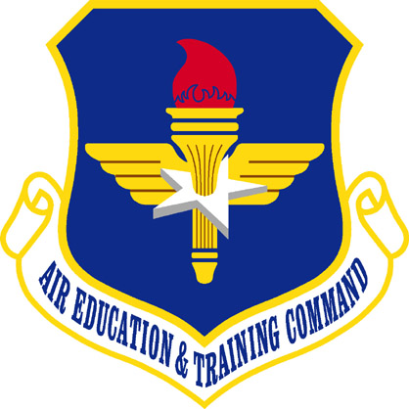
Sustaining the Combat Capability of America’s Air Force
I n t e g r i t y - S e r v i c e - E x c e l l e n c e

